Slide 1
Inventory Management
MINI PROJECT
BY -: Kunal Waldia
Section-A-RQ

Slide 2

Introduction
Choosing inventory management as a mini-project can be a practical and valuable decision for several reasons:-
Real-world applicability:
Problem-solving skills:
Business understanding:
Integration of technologies:

Slide 3

Key Features-:
Show Products
Update items
Add New Product

Slide 4
Problems faced on inventory management
Maintainance of Daily record:- Inventory systems deal with a significant amount of data.
Working on such a project allows you to explore data management techniques, including database design
and data analytic which ulitmately solve the problem of maintainace of records.
Order Management:- with the increase in amount of demand and supply its is now very difficult to manage the
Order for business standared and with technology this probllem can be easily solved.
Solution
With the technology we tried to take glimspe on the problem and made a project having basic features for the
User to ADD Product ,Update quantity of Products and can view ALL Products at once.
We made a simple web development project to perform different task .

Slide 5
Technologies Used-:
TECHNOLOGIES
HTML
(used while making EJS templates)
CSS
(to improve UI)
Node JS
( to run JavaScript in server side)
EXPRESS
(to handle HTTP requests)
EJS
(to create dynamic web pages)
SQL DATABASE
(to store data)
HTML
CSS
Node JS
EXPRESS
EJS
SQL DATABASE
UUID V4 Nodemon
Method – Override
Package Req:-

Slide 6
FEATURES
We have ADD , Update and show Products features:-

Slide 7
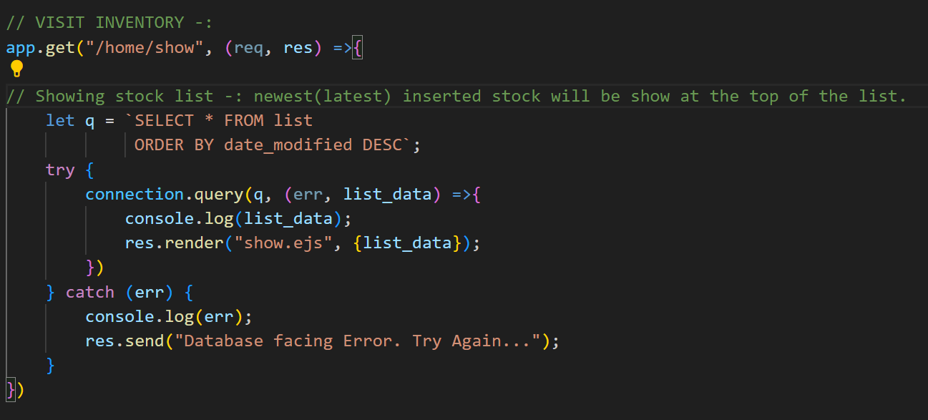
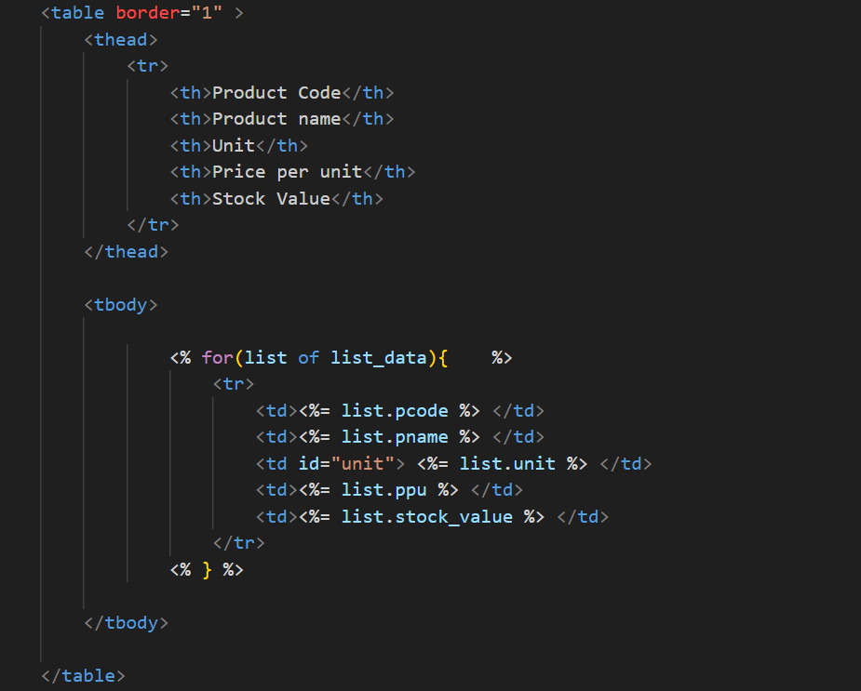
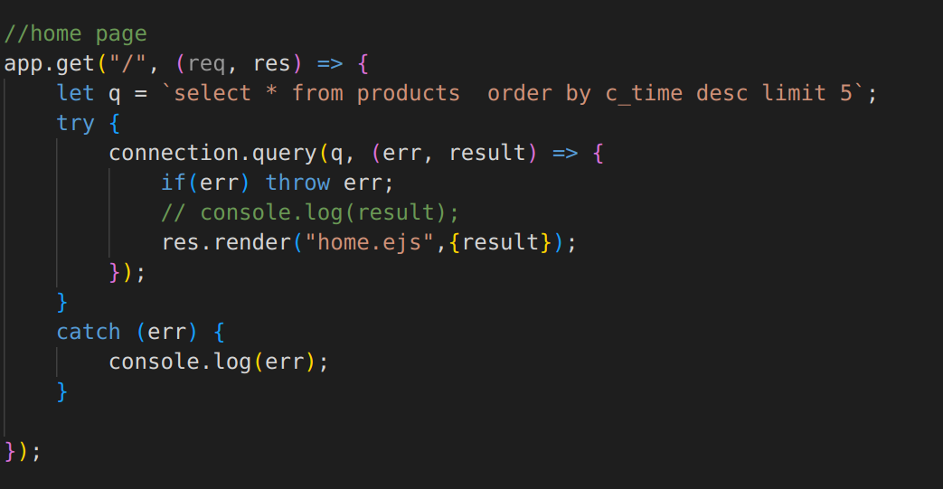
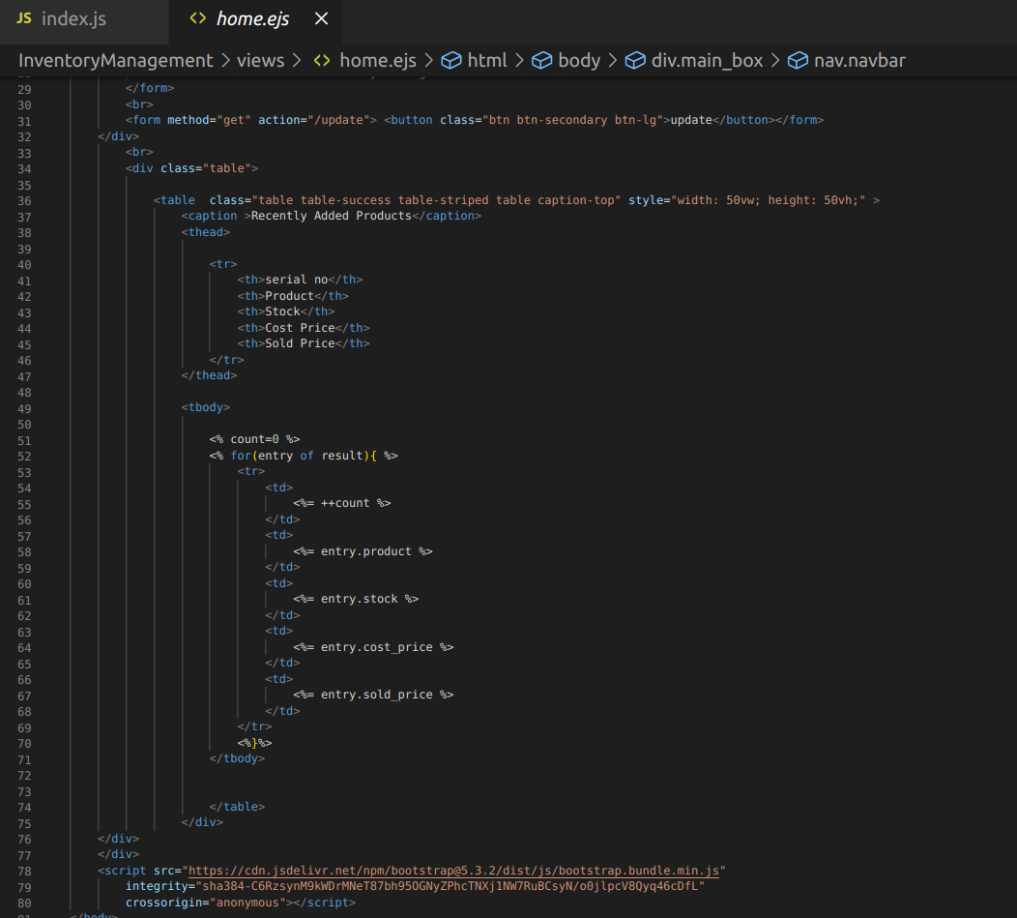
HOME PAGE

Slide 8
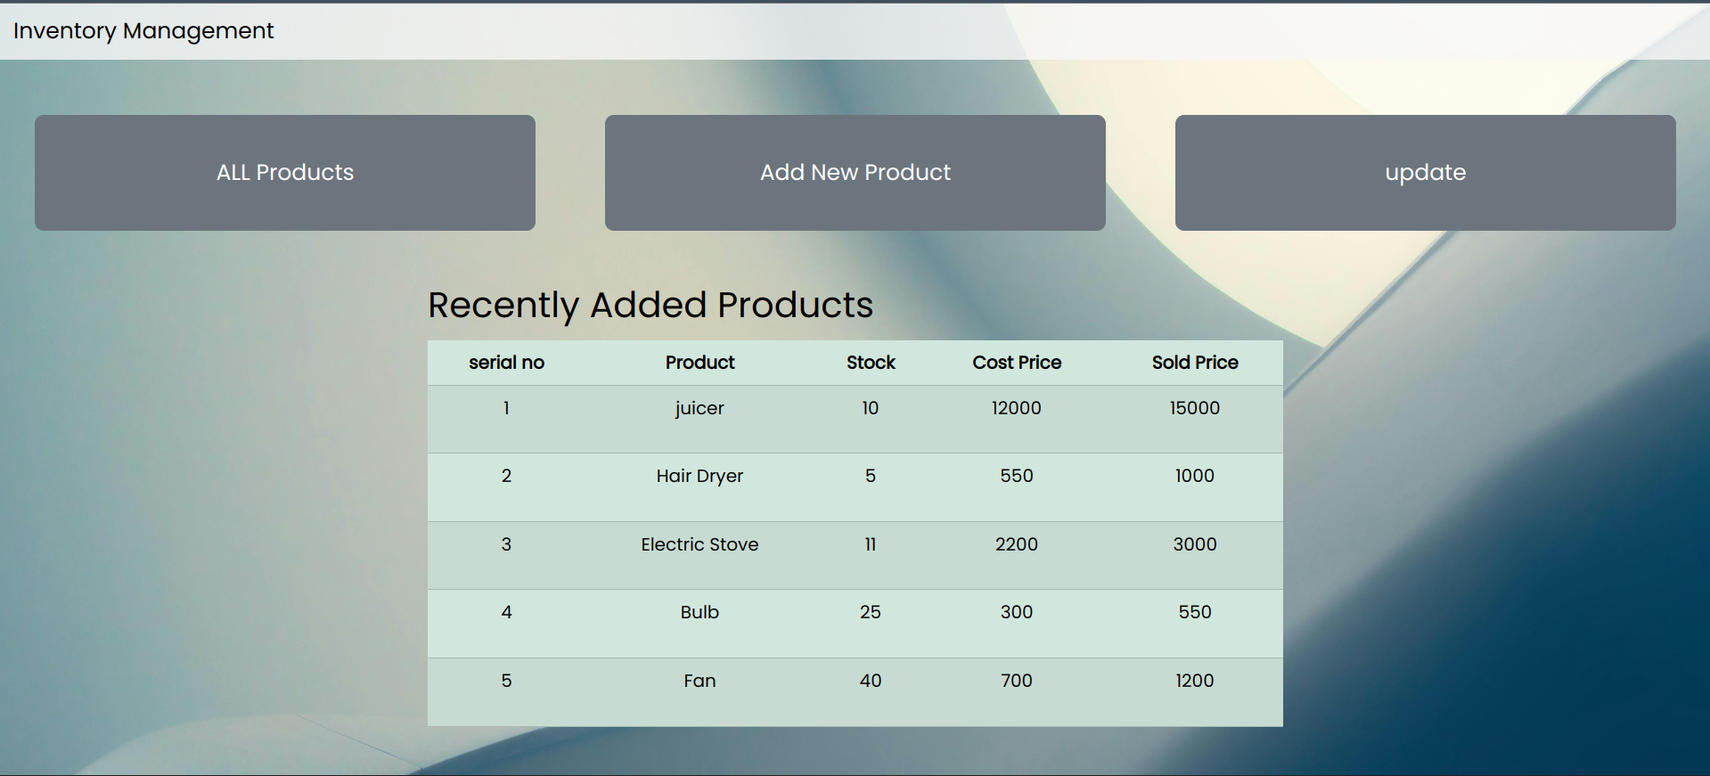
HOME PAGE

Slide 9
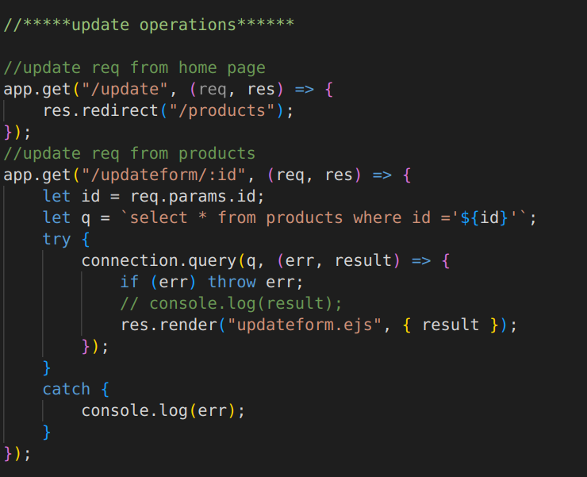
Update Inventory

Slide 10
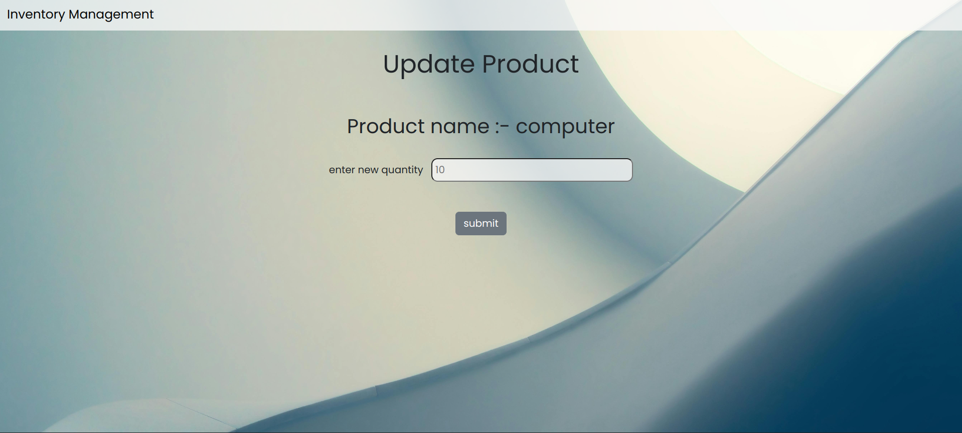
Update Inventory

Slide 11
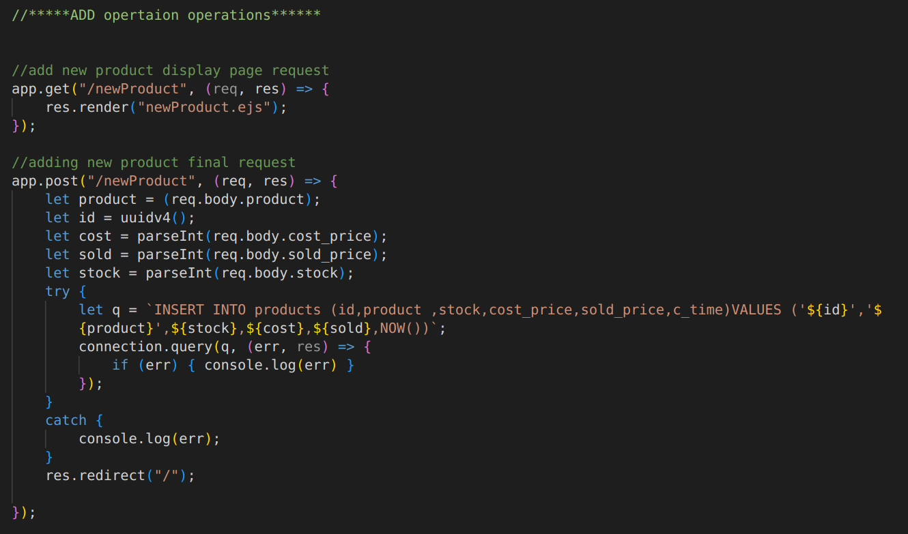
ADD New Product

Slide 12
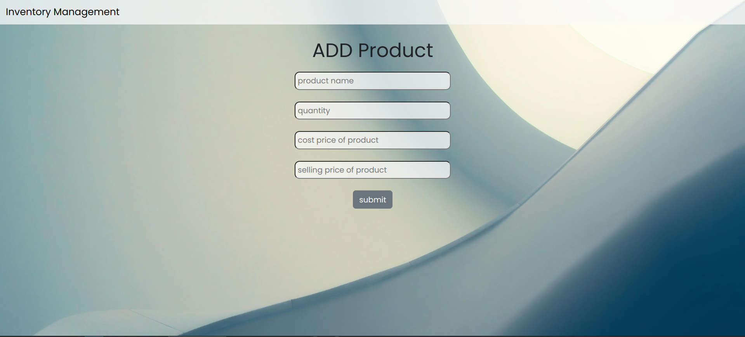
Add New Product

Slide 13
THANK YOU!
Refrences:- https://getbootstrap.com/
https://www.npmjs.com/
https://developer.mozilla.org/en-US/

